Slide 1
Lecture 3 Introduction to Machine Learning Fall Semester 2020-2021 ⇨ Key problems of AI and Human Intelligence (HI)
András Lőrincz
Department of Artificial Intelligence
Faculty of Informatics

Slide 2
The Mystery

Slide 3
The mystery of intelligence
Scientific discoveries of 20 000 years – many—many years and many-many billions of people
can be transferred to a child in about 20 years (for the end of the university)
it is very fast, due to
component learning
linear proofs of combinatorial problems, e.g.,
traveling salesman problem
mathematical theorems
scientific papers
Issues
Learning of components in order to overcome the curse of dimensions
Manipulation of components in order to make statements with linear proofs
Context based modulation of the interpretation of the components
Rule based correction of decisions and classifications
Self-training via rule-based corrections
Is it hard to find the components?
Missing
Crowdsourced
databases may make
AI surprisingly efficient

Slide 4
The problem

Slide 5
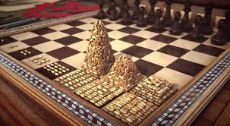

The main problem: Curse of dimensionality
Consider a finite world of dimension n (number of variables)
normalize all dimensions to scale between -1 and +1
draw the maximal ’sphere’
The curse
dimension of HD image ~ 10⁶
’hedgehog thorns’ of length 999 (!)
2^{1,000,000} of them (!!...!!)
(is the base „2” true?)
makes hard to search for the optimal solution
Furthermore, the human brain
can handle not more than cca. 7±2 (~2³) components at a time
How big is 2⁵⁰? How big is 2⁶³?
$$\sqrt{n}−1$$
1

Slide 6
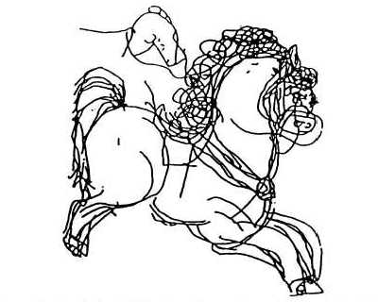
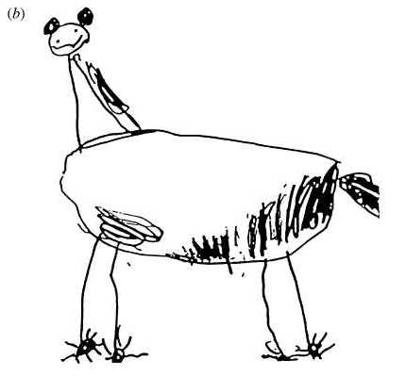
Components
Recall:
First type of recognition
What is this?
Horse
How do you know?
Second type of recognition
What is this?
Horse?
Why do you think so?

Slide 7
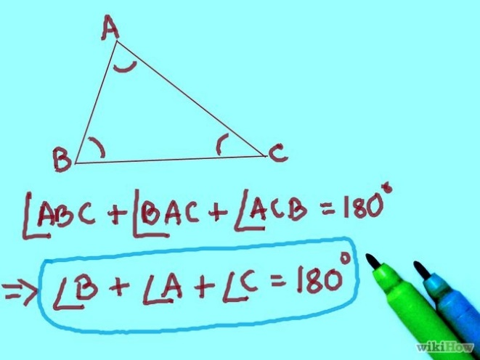

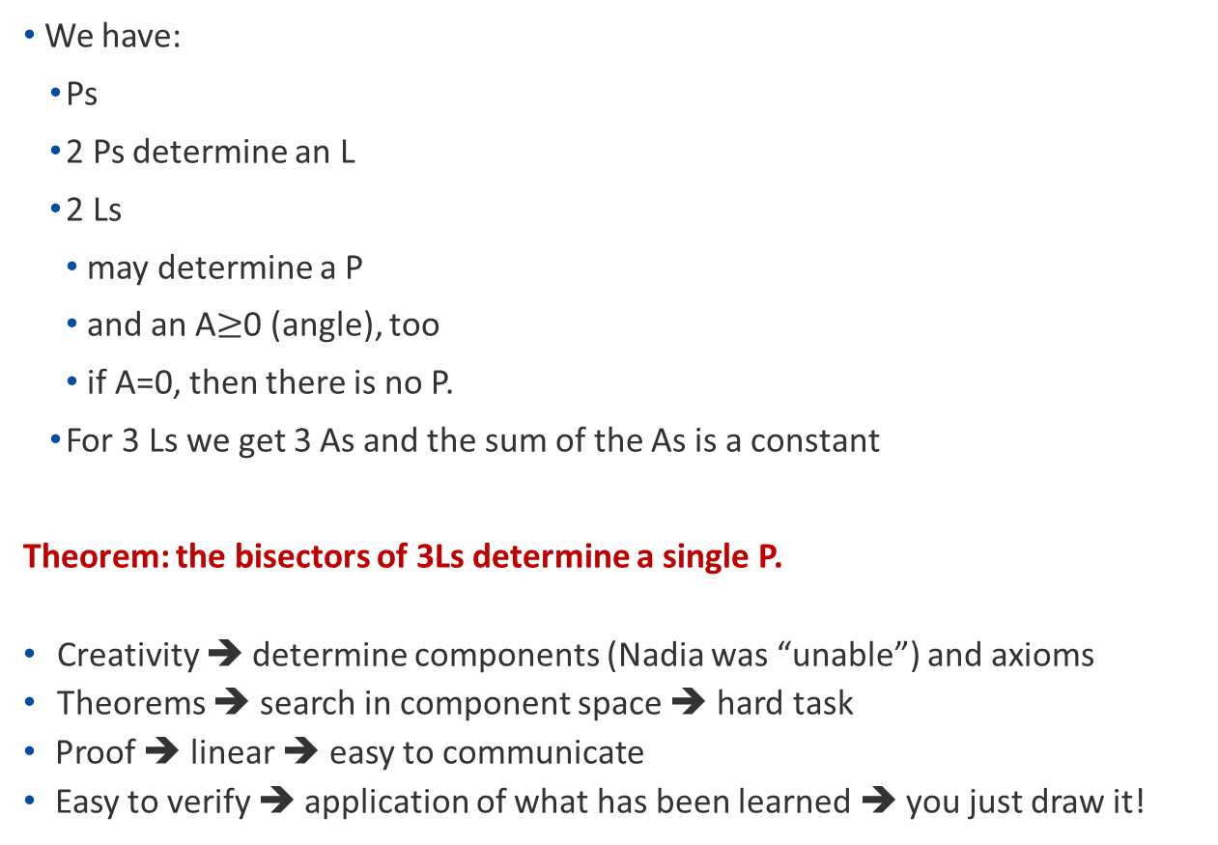
Conceptual components
We have:
Ps
2 Ps determine an L
2 Ls
may determine a P
and an A$≥$0 (angle), too
if A=0, then there is no P.
For 3 Ls we get 3 As and the sum of the As is a constant
Theorem: the bisectors of 3Ls determine a single P.
Creativity ➔ determine components (Nadia was “unable”) and axioms
Theorems ➔ search in component space ➔ hard task
Proof ➔ linear ➔ easy to communicate
Easy to verify ➔ application of what has been learned ➔ you just draw it!

Slide 8
The mystery of intelligence
Scientific discoveries of 20 000 years – many—many years and many-many billions of people
can be transferred to a child in about 20 years (for the end of the university)
it is very fast, due to
component learning (no learning in high dimension, if you know „horse” and „stripe”)
linear proofs of combinatorial problems, e.g.,
traveling salesman problem
mathematical theorems
scientific papers
Issues
Learning of components in order to overcome the curse of dimensions
Manipulation of components in order to make statements with linear proofs
Context based modulation of the interpretation of the components
Rule based correction of decisions and classifications
Self-training via rule-based corrections
Is it hard to find the components?
Missing
Crowdsourced
databases may make
AI surprisingly efficient

Slide 9
Discretization and Metric

Slide 10
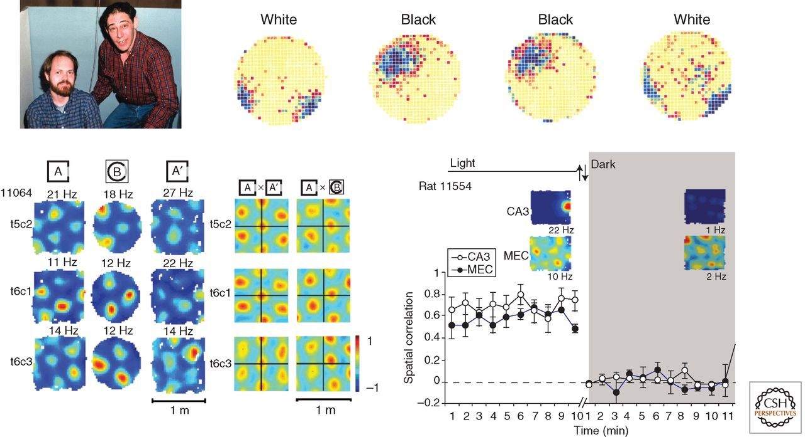
Mammalian (e.g., rat & monkey) brain ’knows’ the trick
May-Britt Moser et al. Cold Spring Harb Perspect Biol 2015;7:a021808
Nobel Laurates (2014) O’Keefe + Edvard Moser + May-Britt Moser
Place
Metric
Adaptation
Remapping in place cells and grid cells. (Top left) John Kubie and Bob Muller in 1983. (Top right) Color-coded firing rate map for a hippocampal place cell from an early remapping experiment (purple, high rate; yellow, low rate). The cell fired at different locations in different versions of the recording cylinder, one with a black cue card and one with a white cue card. (Bottom left) Realignment of entorhinal grid cells under conditions that generate global remapping in the hippocampus. The rat was tested in boxes with square or circular surfaces. The left panel shows color-coded rate maps for three grid cells (t5c2, t6c1, and t6c3). The right panel shows cross-correlation maps for pairs of rate maps (same grid cells as in the left panel; repeated trials in A or one trial in A and one trial in B). The cross-correlation maps are color-coded, with red corresponding to high correlation and blue to low (negative) correlation. Note that the center of the cross-correlation map is shifted in the same direction and at a similar distance from the origin in all three grid cells, suggesting that all grid cells in an ensemble respond coherently to changes in the environment very much unlike the remapping that is observed in the hippocampus. (Bottom right) Response to a change in the environment (darkness) in a simultaneously recorded pair of grid and place cells. (Top left photo courteously provided by John Kubie; top right image is modified from data in Bostock et al. 1991; bottom image from Fyhn et al. 2007; reprinted, with permission, from the authors and Nature Publishing Group © 2007.)‏
©2015 by Cold Spring Harbor Laboratory Press
Notes:
Remapping in place cells and grid cells. (Top left) John Kubie and Bob Muller in 1983. (Top right) Color-coded firing rate map for a hippocampal place cell from an early remapping experiment (purple, high rate; yellow, low rate). The cell fired at different locations in different versions of the recording cylinder, one with a black cue card and one with a white cue card. (Bottom left) Realignment of entorhinal grid cells under conditions that generate global remapping in the hippocampus. The rat was tested in boxes with square or circular surfaces. The left panel shows color-coded rate maps for three grid cells (t5c2, t6c1, and t6c3) (color coded as in Fig. 1). The right panel shows cross-correlation maps for pairs of rate maps (same grid cells as in the left panel; repeated trials in A or one trial in A and one trial in B). The cross-correlation maps are color-coded, with red corresponding to high correlation and blue to low (negative) correlation. Note that the center of the cross-correlation map is shifted in the same direction and at a similar distance from the origin in all three grid cells, suggesting that all grid cells in an ensemble respond coherently to changes in the environment very much unlike the remapping that is observed in the hippocampus. (Bottom right) Response to a change in the environment (darkness) in a simultaneously recorded pair of grid and place cells. (Top left photo courteously provided by John Kubie; top right image is modified from data in Bostock et al. 1991; bottom image from Fyhn et al. 2007; reprinted, with permission, from the authors and Nature Publishing Group © 2007.)‏

Slide 11
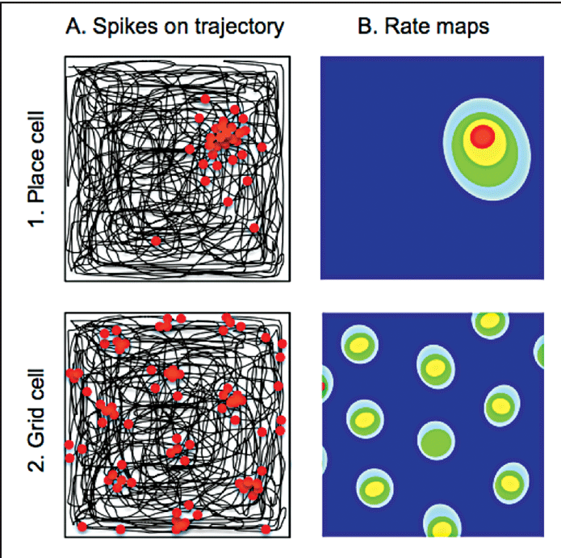
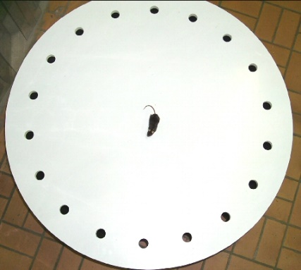
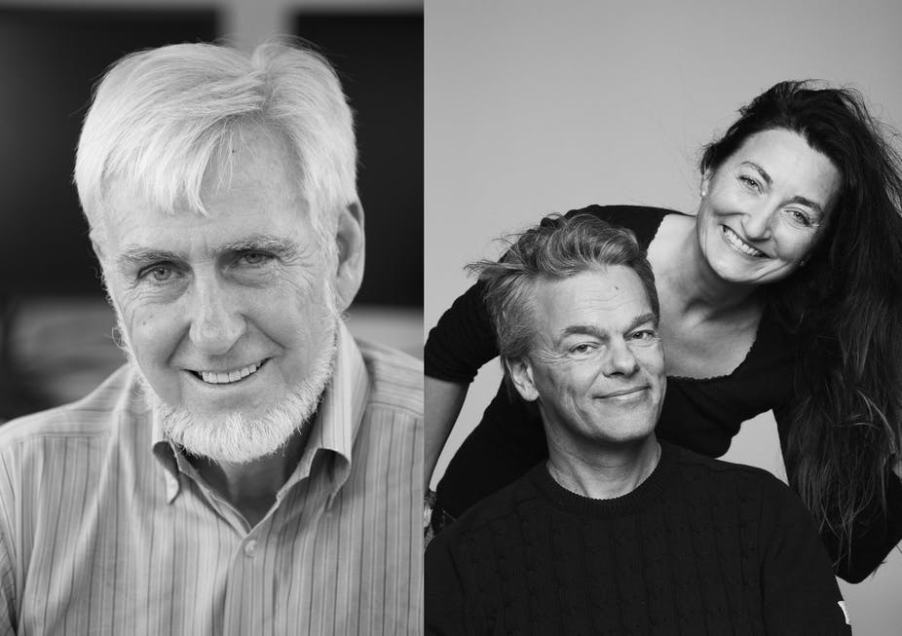
The trick of the brain
https://en.wikipedia.org/wiki/Barnes_maze#/media/File:Barnes_maze.jpg
How about bats?
How about cognition?
May-Britt Moser et al. Cold Spring Harb Perspect Biol 2015;7:a021808 O’Keefe + Edvard Moser + May-Britt Moser
Place
Metric
Notes:
Remapping in place cells and grid cells. (Top left) John Kubie and Bob Muller in 1983. (Top right) Color-coded firing rate map for a hippocampal place cell from an early remapping experiment (purple, high rate; yellow, low rate). The cell fired at different locations in different versions of the recording cylinder, one with a black cue card and one with a white cue card. (Bottom left) Realignment of entorhinal grid cells under conditions that generate global remapping in the hippocampus. The rat was tested in boxes with square or circular surfaces. The left panel shows color-coded rate maps for three grid cells (t5c2, t6c1, and t6c3) (color coded as in Fig. 1). The right panel shows cross-correlation maps for pairs of rate maps (same grid cells as in the left panel; repeated trials in A or one trial in A and one trial in B). The cross-correlation maps are color-coded, with red corresponding to high correlation and blue to low (negative) correlation. Note that the center of the cross-correlation map is shifted in the same direction and at a similar distance from the origin in all three grid cells, suggesting that all grid cells in an ensemble respond coherently to changes in the environment very much unlike the remapping that is observed in the hippocampus. (Bottom right) Response to a change in the environment (darkness) in a simultaneously recorded pair of grid and place cells. (Top left photo courteously provided by John Kubie; top right image is modified from data in Bostock et al. 1991; bottom image from Fyhn et al. 2007; reprinted, with permission, from the authors and Nature Publishing Group © 2007.)‏

Slide 12
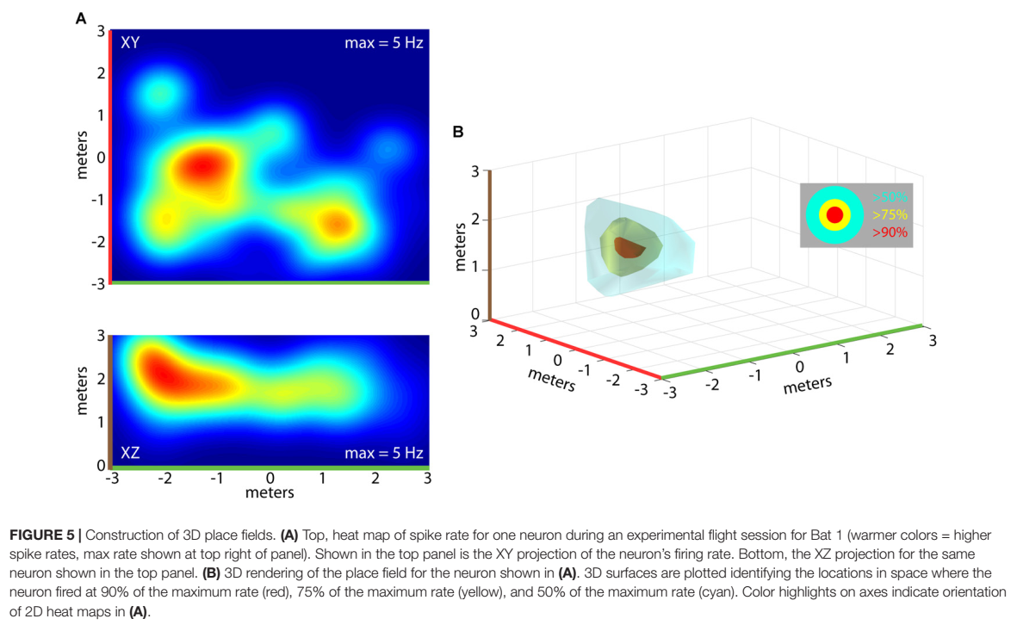
Bats
ORIGINAL RESEARCH ARTICLE
Front. Cell. Neurosci., 23 August 2018 | https://doi.org/10.3389/fncel.2018.00270
3D Hippocampal Place Field Dynamics in Free-Flying Echolocating Bats
Melville J. Wohlgemuth, Chao Yu, and Cyntia F. Moss

Slide 13
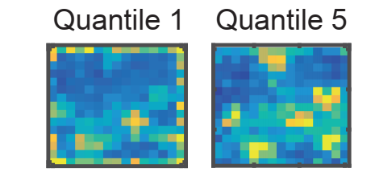
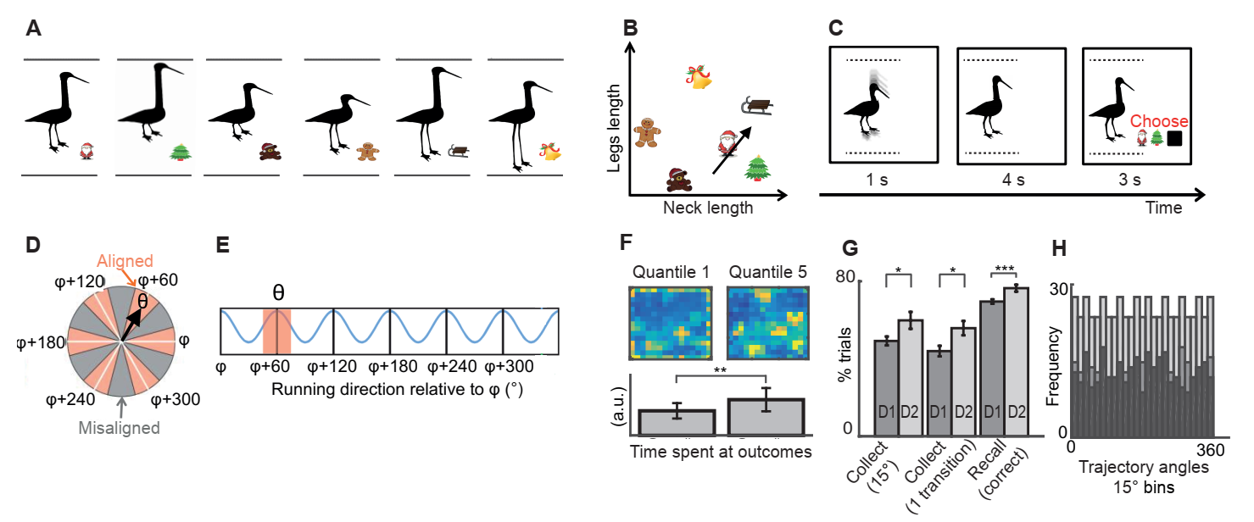
Constantinescu, A.O., O’Reilly, J.X. and Behrens, T.E.
Organizing conceptual knowledge in humans with a gridlike code.
Science, 352 (6292), pp.1464-1468 (2016)
Cognition
Beginning of training End of training

Slide 14
Interpretation and ambiguity

Slide 15
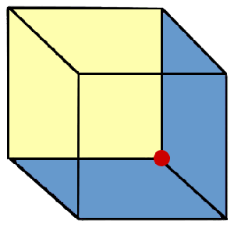
Interpretation – and the problem of synchronization
Distributed computing
The problem of delays
200 ms (vision) + 200 ms (control) + 100 ms (processing)
5 m in 100 m sprint…
Only one of them is available at a time
We can’t control which one
We can’t switch from one to the other
We can’t keep one of them
Either of them stays for about 500 ms – 700 ms
Interpretation:
model based and synchronized
input and (single) interpretation
lasts over a longer time period → it is a must
Lemaitre, Anne-Laure, Marion Luyat, and Gilles Lafargue.
Consciousness and cognition 41 (2016): 64-71.
Individuals with pronounced schizotypal traits are particularly successful in tickling themselves.

Slide 16
Crowdsourced Intelligence
Putative example on
crowdsourced, many component deep-networks with
consistency seeking followed by
actions and self-training

Slide 17
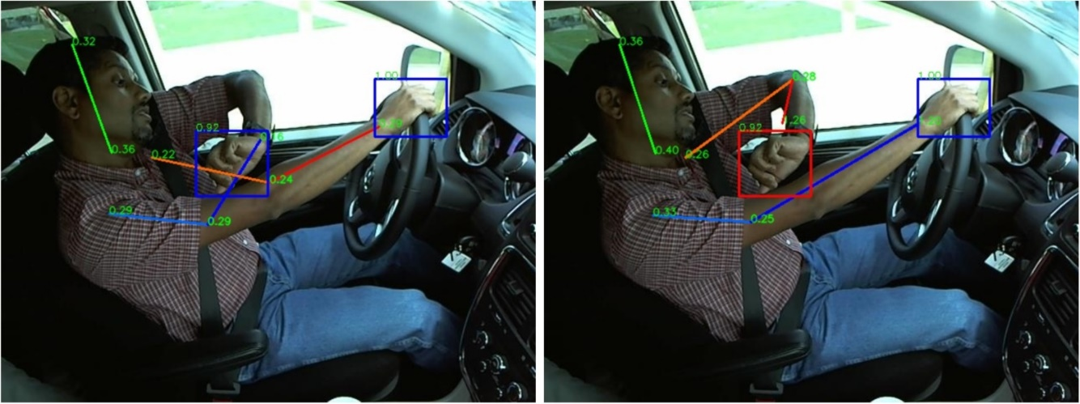
Self-training 1: Inference on NN outputs
Crowdsourced or Natural Intelligence Quotient?
Blue: right
Red: left
Contradiction – he has two right hands!
Score on the steering wheel is high: this is the right hand…
The other one is the left hand…
Evaluation should be constrained accordingly…
OK!!
AI has two new samples for self-training…

Slide 18
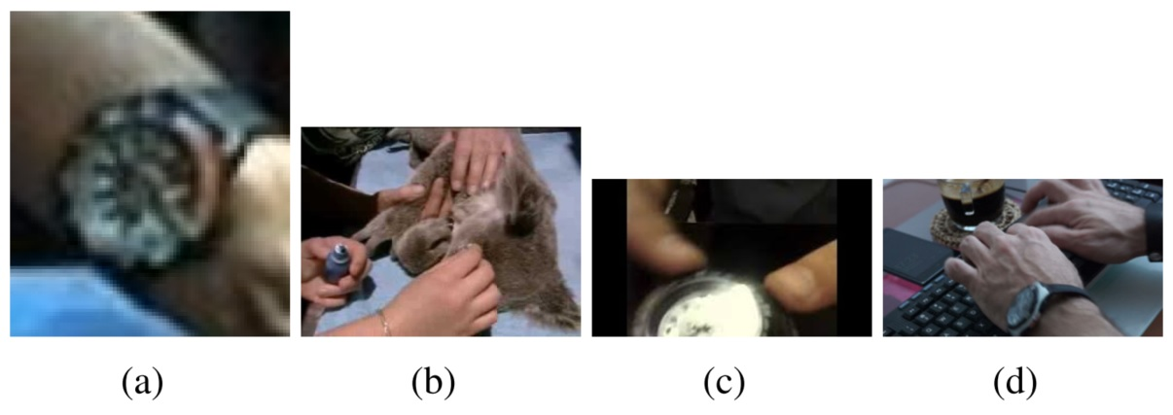
Self-training 2: Inference on BIG DATA
Crowdsourced or Natural Intelligence Quotient?
What is the driver looking at?
Send to Google Images and read captions:
it is an animal
Hmmm… in a car, in the driver’s seat?
Plus info: the target of the gaze is close to the wrist
Restrict search by the word wrist.
Captions say: wristwatch
Lőrincz, A., Máté Csákvári, Áron Fóthi, Z. Ádám Milacski, András Sárkány, and Z. Tősér. "Towards reasoning based representations: Deep Consistence Seeking Machine." Cognitive Systems Research 47 (2018): 92-108.

Slide 19

Crowdsourced or Natural Intelligence Quotient?
Self-training 3: Inference on knowledge base
Thus, he is looking at his wristwatch
What is the wristwatch used for? Ask ConceptNet:
Puzzle solved, action has become possible…
Machine will learn from behavioral feedback

Slide 20
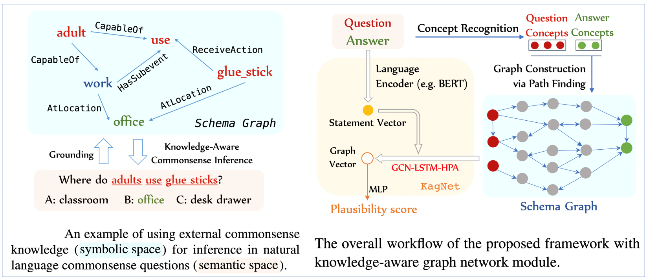
If you are interested in NLP and dialogs
https://github.com/INK-USC/KagNet
KagNet: Knowledge-Aware Graph Networks for Commonsense Reasoning
It uses ConceptNet

Slide 21
This
is the
END!
BUT go further
for homeworks and
for the questions!
lorincz@inf.elte.hu

Slide 22
Questions and Notes 1
What are the complexity classes?
exp vs polinomial and training vs solving → 4 types
What complexity class is worth to communicate?
What does the complexity of an optimization task depend on?
What may creativity be? (Concept formation, like axiomes of geometry)
What may intelligence be? (Cognitive manipulation of the concepts, like in IQ tests.
What is crowdsourcing?
What is the course of dimensionality?
What is the solution of the course of dimensionalityM

Slide 23
Questions and Notes 2
What is the population code? (This was not part of the talk... More neurons are active at the same time. For example, motion is sensed by many neurons with changing activities (activities are always positive, since neurons can only provide spikes). These neurons have a main direction. Their activities depend on the angle between their main direction and the actual motion according to the cosine function. Together (their average) provides a very precise direction estimation.)
What is the population code of the 2D discretization? There was an image from the literature on this (Approx. Gaussian activities)
What is the population code of the 2D metric? (Many neurons respond according to a hexagonal grid with different grid sizes.)

Slide 24
Questions and Notes 3
Why is it a haxagonal grid in 2D? (Because local close packing of circles in 2D is commensurable with the global close packing. Both correspond to the hexagonal grid. This is not true in 3D: local close packing of spheres differes from global closest packing of speheres)
What is the Necker cube illusion? https://hu.wikipedia.org/wiki/Necker-kocka https://en.wikipedia.org/wiki/Necker_cube
How can one try to explain the temporal changes in this illusion, namely that these changes can’t be stopped and can’t be accelerated for most people? (Delay compensation for synchronization in distributed cognitive systems should be based on internal model and the model has its constraints subject to the full delays in the processing loops.)

Slide 25
Questions and Notes 4
How may one stop the changes? Who may be capable of doing so? (Those people, who can act upon their subconscious: mediation masters: Meditation alters perceptual rivalry in Tibetan Buddhist monks -- http://www.uq.edu.au/nuq/jack/CBMonks.pdf)
What is ConceptNet? http://conceptnet.io/
Recall that input-output systems can hardly make sense of images. How can we use Google Images for making sense of images?
How can one use deep networks for generating new training samples? (Via resolving the discrepancies between the outputs of the networks.)
What if the result of the resolution of discrepancy is wrong? How can it be improved? (Only be behavioral feedback.)

